Slide 1
Composite Materials
Credit:
Name : Nirbhey Singh Pahwa.
Class : INFT-3
Subject : Applied Chemistry-II

Slide 2
Composite Material Diagnosed
A composite material is made by combining two or more materials – often ones that have very different properties.
The two materials work together to give the composite unique properties.
However, within the composite you can easily tell the different materials apart as they do not dissolve or blend into each other.

Slide 3
ADVANTAGES OF COMPOSITE.
Reason to use composite material:-
Higher specific strength than metals, non-metals and even alloys.
Lower specific gravity in general.
Improved stiffness of material.
Composite maintain their weight even at high temperatures.
Toughness is improved.
Fabrication or production is cheaper.
Creep and fatigue strength is better.
Controlled Electrical conductivity is possible.
Corrosion and oxidation resistance.

Slide 4
They generally have two phases:-
Matrix Phase.
Dispersion Phase.
Matrix Phase :-
It is the continuous material constituent which encloses the composite and give it its bulk form.
Matrix phase may be metal , ceramic or polymer.
Dispersion Phase:-
It is the structure constituent , which determines the internal structure of composite.
Dispersion Phase is connected to matrix phase by bonding

Slide 5
Types of composites.
Composite.
Particle-reinforced
Fibre-reinforced
Structural
Large particle
Dispersion- strengthened
Continuous (Alignment)
Discontinuous (Short)
Laminates
Sandwich panels
Aligned
Randomly oriented

Slide 6
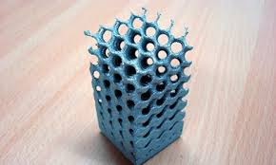
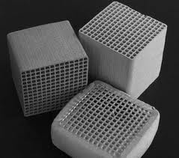
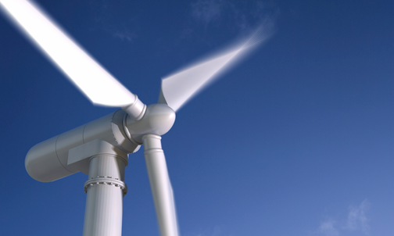
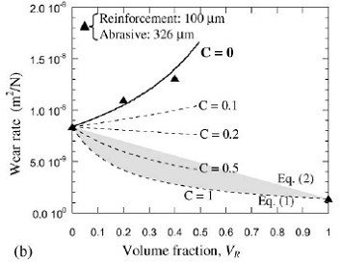
Particle Reinforced Composites
One form of composites is particulate reinforced composites with concrete being a good example. The aggregate of coarse rock or gravel is embedded in a matrix of cement. The aggregate provides stiffness and strength while the cement acts as the binder to hold the structure together.
There are many different forms of particulate composites. The particulates can be very small particles (< 0.25 microns), chopped fibres (such as glass), platelets, hollow spheres, or new materials such as Bucky balls or carbon nano-tubes. In each case, the particulates provide desirable material properties and the matrix acts as binding medium necessary for structural applications.

Slide 7
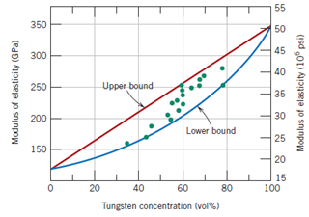


Large-particle composite
Some polymeric materials to which fillers have been added are really large- particle composites. The fillers modify or improve the properties of the material. Example of large-particle composite is concrete, which is composed of cement (the matrix), and sand and gravel (the particulates).Particles can have quite a variety of geometries, but they should be of approximately the same dimension in all direction (equated).
For effective reinforcement, the particles should be small and evenly distributed throughout the matrix. The volume fraction of the two phases influences the behavior; mechanical properties are enhanced with increasing particulate content.
Rule of mixture: equation predict that the elastic modulus should fall between an upper and lower bound as shown:
Example: Fig. 1.1 plots upper and lower bound Ec – versus Vp curves for a copper – tungsten composite; in which tungsten is the particulate phase.
Where:-
Ec: elastic modulus of composite
Ep: elastic modulus of particle
Em: elastic modulus of matrix
Vm: volume fraction of matrix
Vp: volume fraction of particle

Slide 8
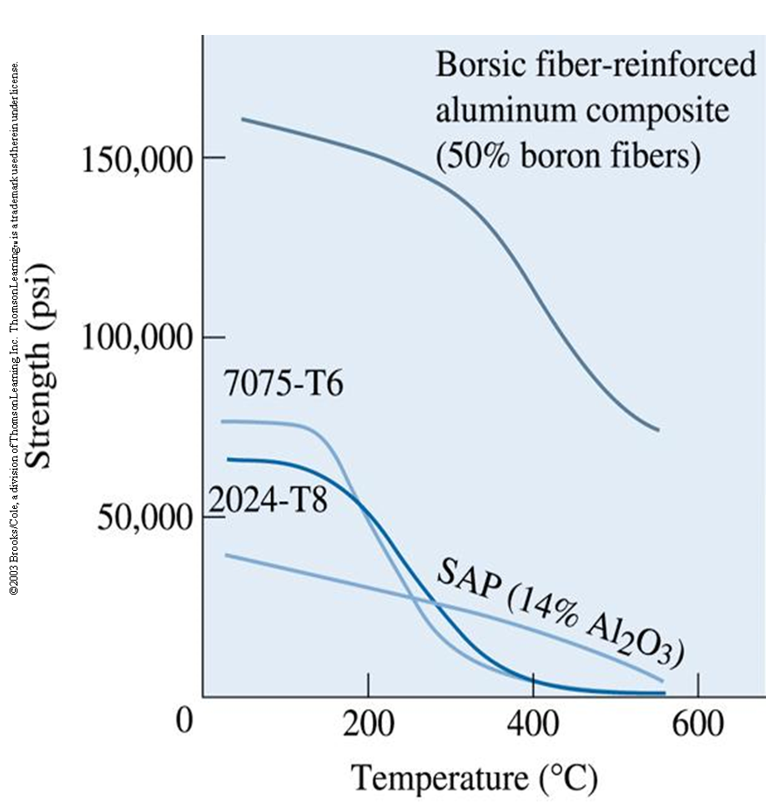
Dispersion strengthened composite
Dispersion-strengthened means of strengthening materials where in very small particles (usually less than 0.1 µm) of a hard yet inert phase are uniformly dispersed within a load – bearing matrix phase.
The dispersed phase may be metallic or nonmetallic, oxide materials are often used.
Figure 1.2 Comparison of the yield strength of dispersion-strengthened sintered aluminum powder (SAP) composite with that of two conventional two-phase high-strength aluminum alloys. The composite has benefits above about 300°C. A fiber-reinforced aluminum composite is shown for comparison.

Slide 9

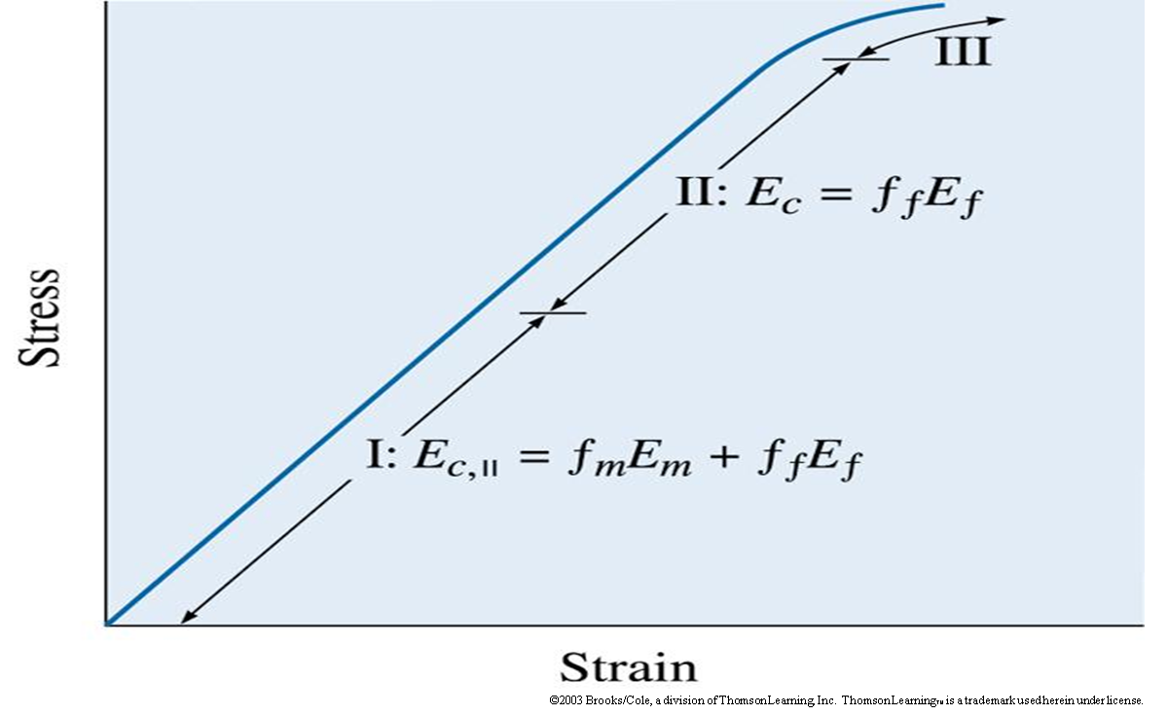
Fiber-Reinforced Composites
The Rule of Mixtures in Fiber-Reinforced Composites
Strength of Composites - The tensile strength of a fiber-reinforced composite (TS_{c}) depends on the bonding between the fibers and the matrix.
Figure 1.3 The stress-strain curve for a fiber-reinforced composite. At low stresses (region l), the modulus of elasticity is given by the rule of mixtures. At higher stresses (region ll), the matrix deforms and the rule of mixtures is no longer obeyed.

Slide 10
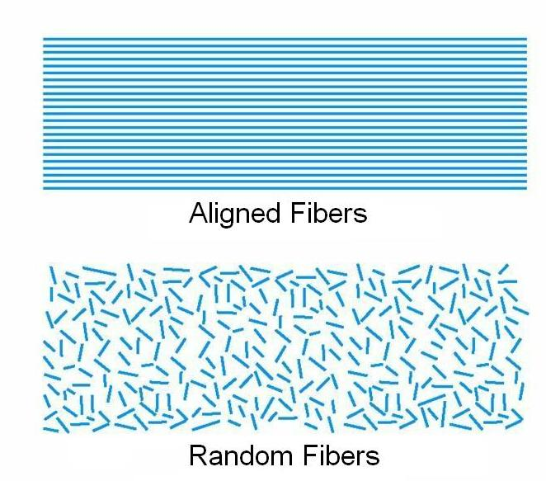
Types of fibre reinforced composite:-
Continuous & Aligned The fibres are longer than a critical length which is the minimum length necessary such that the entire load is transmitted from the matrix to the fibres. If they are shorter than this critical length, only some of the load is transmitted. Fibre lengths greater that 15 times the critical length are considered optimal. Aligned and continuous fibres give the most effective strengthening for fibre composites.

Slide 11
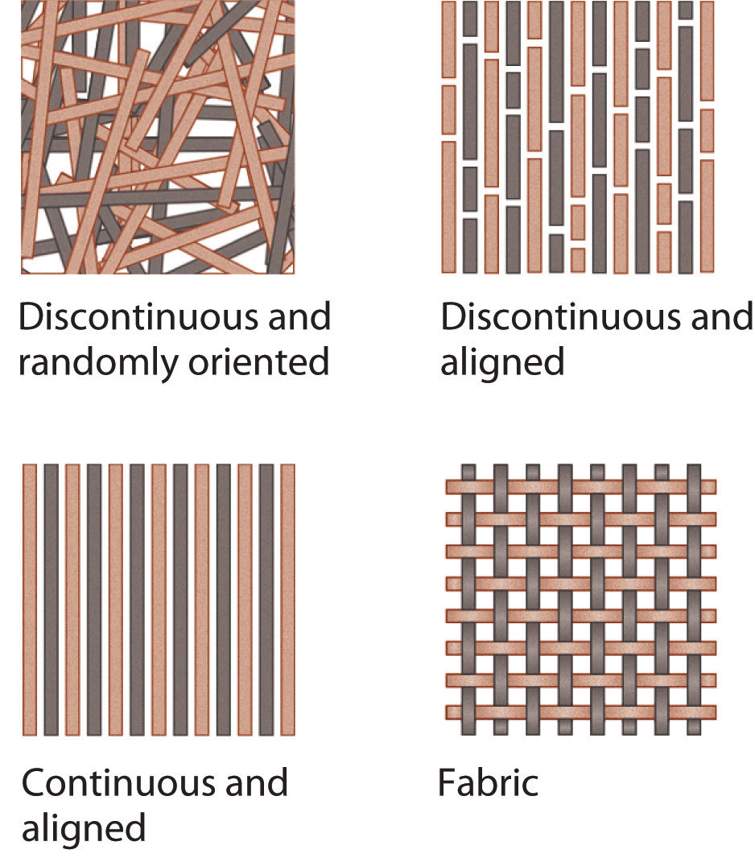
Discontinuous & Aligned The fibres are shorter than the critical length. Hence discontinuous fibres are less effective in strengthening the material, however, their composite modulus and tensile strengths can approach 50-90% of their continuous and aligned counterparts. And they are cheaper, faster and easier to fabricate into complicated shapes.
Random This is also called discrete, (or chopped) fibres. The strength will not be as high as with aligned fibres, however, the advantage is that the material will be isotropic and cheaper.

Slide 12
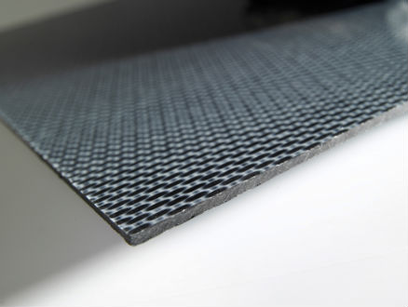
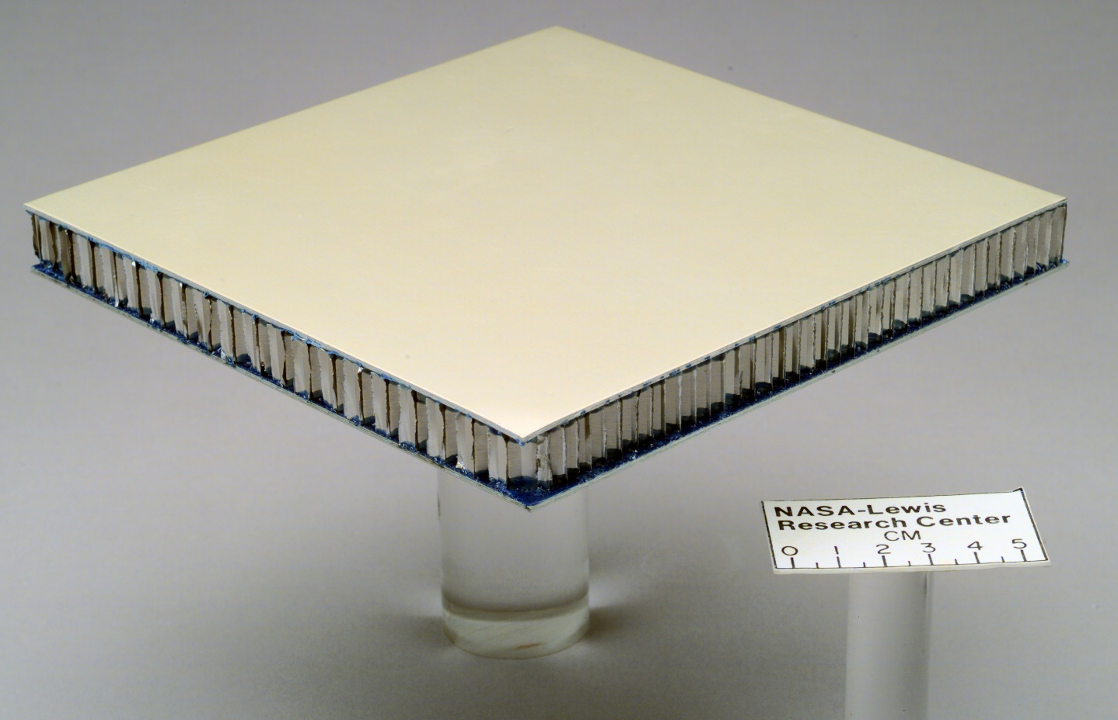
Structural Composites
A structural composite consists of both homogeneous and composite material. There properties depend on, the characteristic properties of the constituent materials as well as the geometric design.
Structural composite are of two types:-
1.Laminar compost 2.Sandwich panel

Slide 13
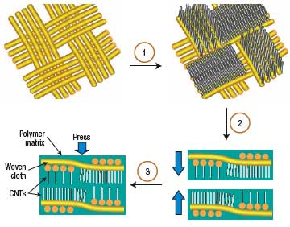
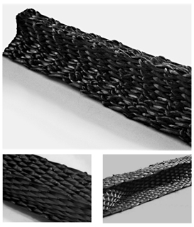
Laminar Composite
It consists of panels or sheets which are two dimensional. These panels possess preferred directions to achieve high strength.
Such successively oriented layers are stacked one above
with preferred directions and then are cemented. Such
an arrangement or orientation ensures varying highest
strength with each successive layer involved in material.

Slide 14
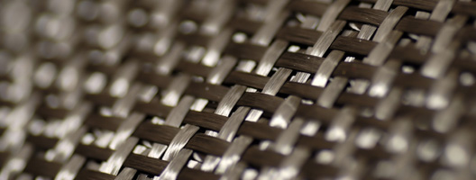
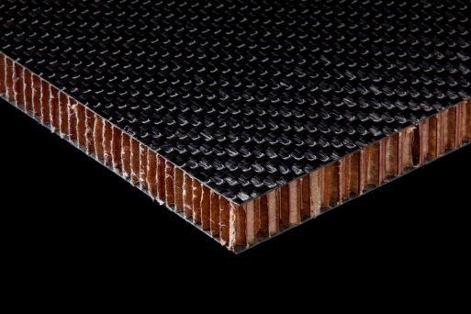
Sandwich Panel
Sandwich panel is also a kind of layered composite. It consists of ‘faces’ and ‘core’
With increase in thickness of core, its stiffness increases as seen in the most common sandwich panel ‘honeycomb’.
Faces:-They are formed by two strong outer sheets.
Core:-Core is layer of less dense material.
Honeycomb:-Structure which contain thin foils forming interlocked hexagonal cells with their axes oriented at right angles in the direction of face sheet.

Slide 15
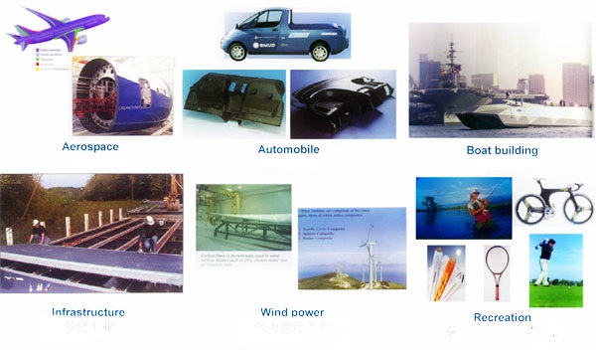
Applications Of Composite Material
In automobile industries (e.g. Steel &Aluminium body)
Marine applications like shafts, hulls, spars (for racing boats)
Aeronautical application like components of rockets, aircrafts (business and military), missiles etc.
Communication antennae, electronic circuit boards (e.g. PCB, breadboard)
Safety equipment like ballistic protection and Air bags of cars.

Slide 16
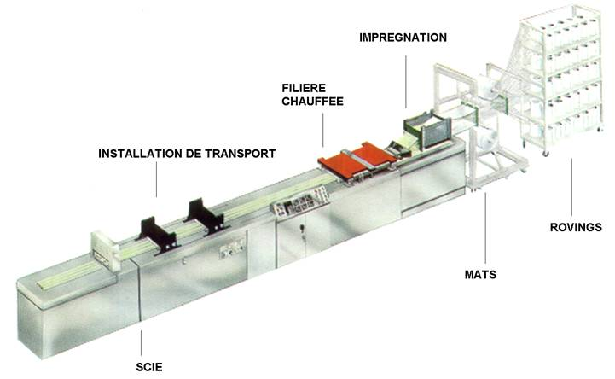
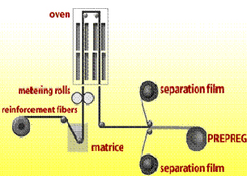
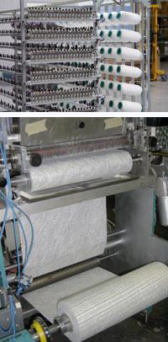
Manufacturing Of Composite Fibre-reinforced composite processing:-
Pultrusion
Prepreg
Technique allowing industrial automated continuous production of profiles from composite materials of synthetic resins. Pultrusion allows the development of various profiles, section and variable thickness. The length of the pultruded profiles is not limited.
It is the term for continuous fibre-reinforcement preimpregnated with a polymer resin that is only particularly cured. The final Prepreg product (the thin tape consisting of continuous an aligned fibbers embedded in partially cured resin) is prepared for packing by winding onto a cardboard core.

Slide 17
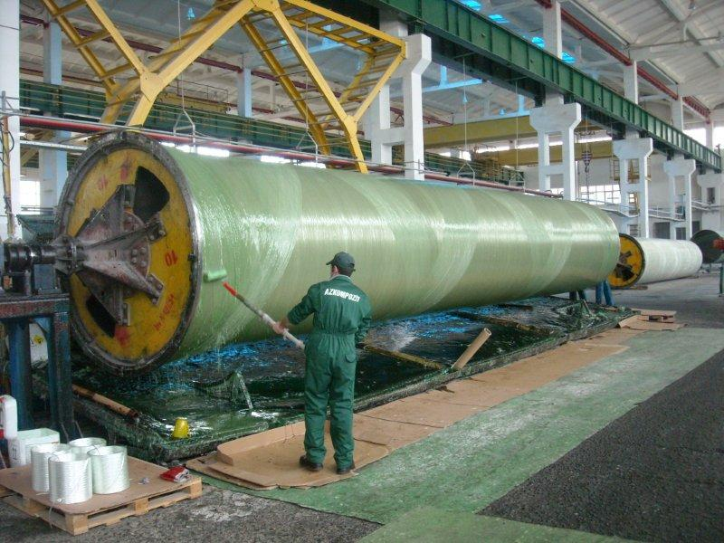
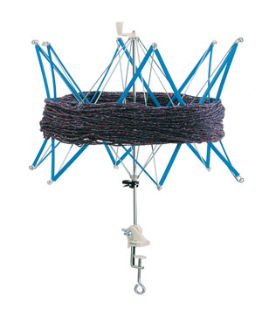
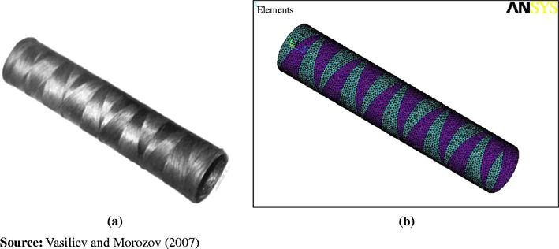
Fabrication From Prepreg
Actual fabrication begins with the lay up(i.e. laying of the Prepreg tape onto a tooled surface).Usually a number of piles are lined up to provide the desired thickness. The lay up arrangement may be unidirectional, but more often the fibre orientation is alternated to reduce either a cross-ply laminated. Final curing is accomplished by simultaneous application of heat and pressure. Some of its methods are:-
1.Helical winding 2.circumferential winding 3.Polar winding

Slide 18
Failure Of Composite Material
Composite can fail due to breaking of the fibre, micro cracking of the matrix, de-bonding (i.e. separation of fibres from matrix), delamination of laminated composite (i.e. separation of lamina from each other).Some of the most common are:-
Failure under longitudinal compressive loading.
Failure under longitudinal tensile loading.
Failure under transverse compressive loading.
Failure under transverse tensile loading.

Slide 19
YOUR IDEAS ON THE COMPOSITES OF THE FUTURE?
Can we innovate more towards the expanding sector of composite material, if yes how?
How to introduce more life applications of composite material in daily scenario?
Making the idea spread to the consumer.
Potential stock market enhancement of composite industries.

Slide 20
THANK YOU FOR WATCHING

